Slide 1

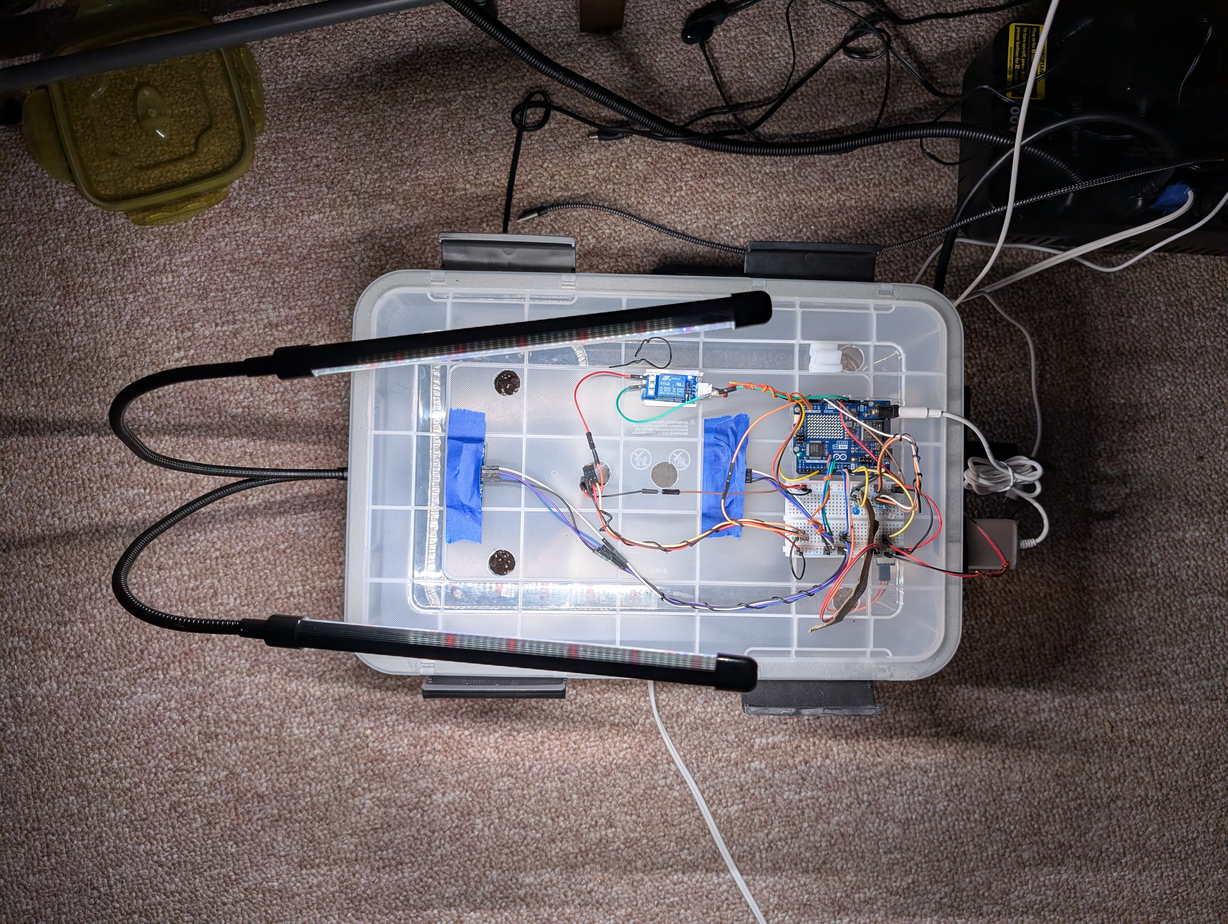
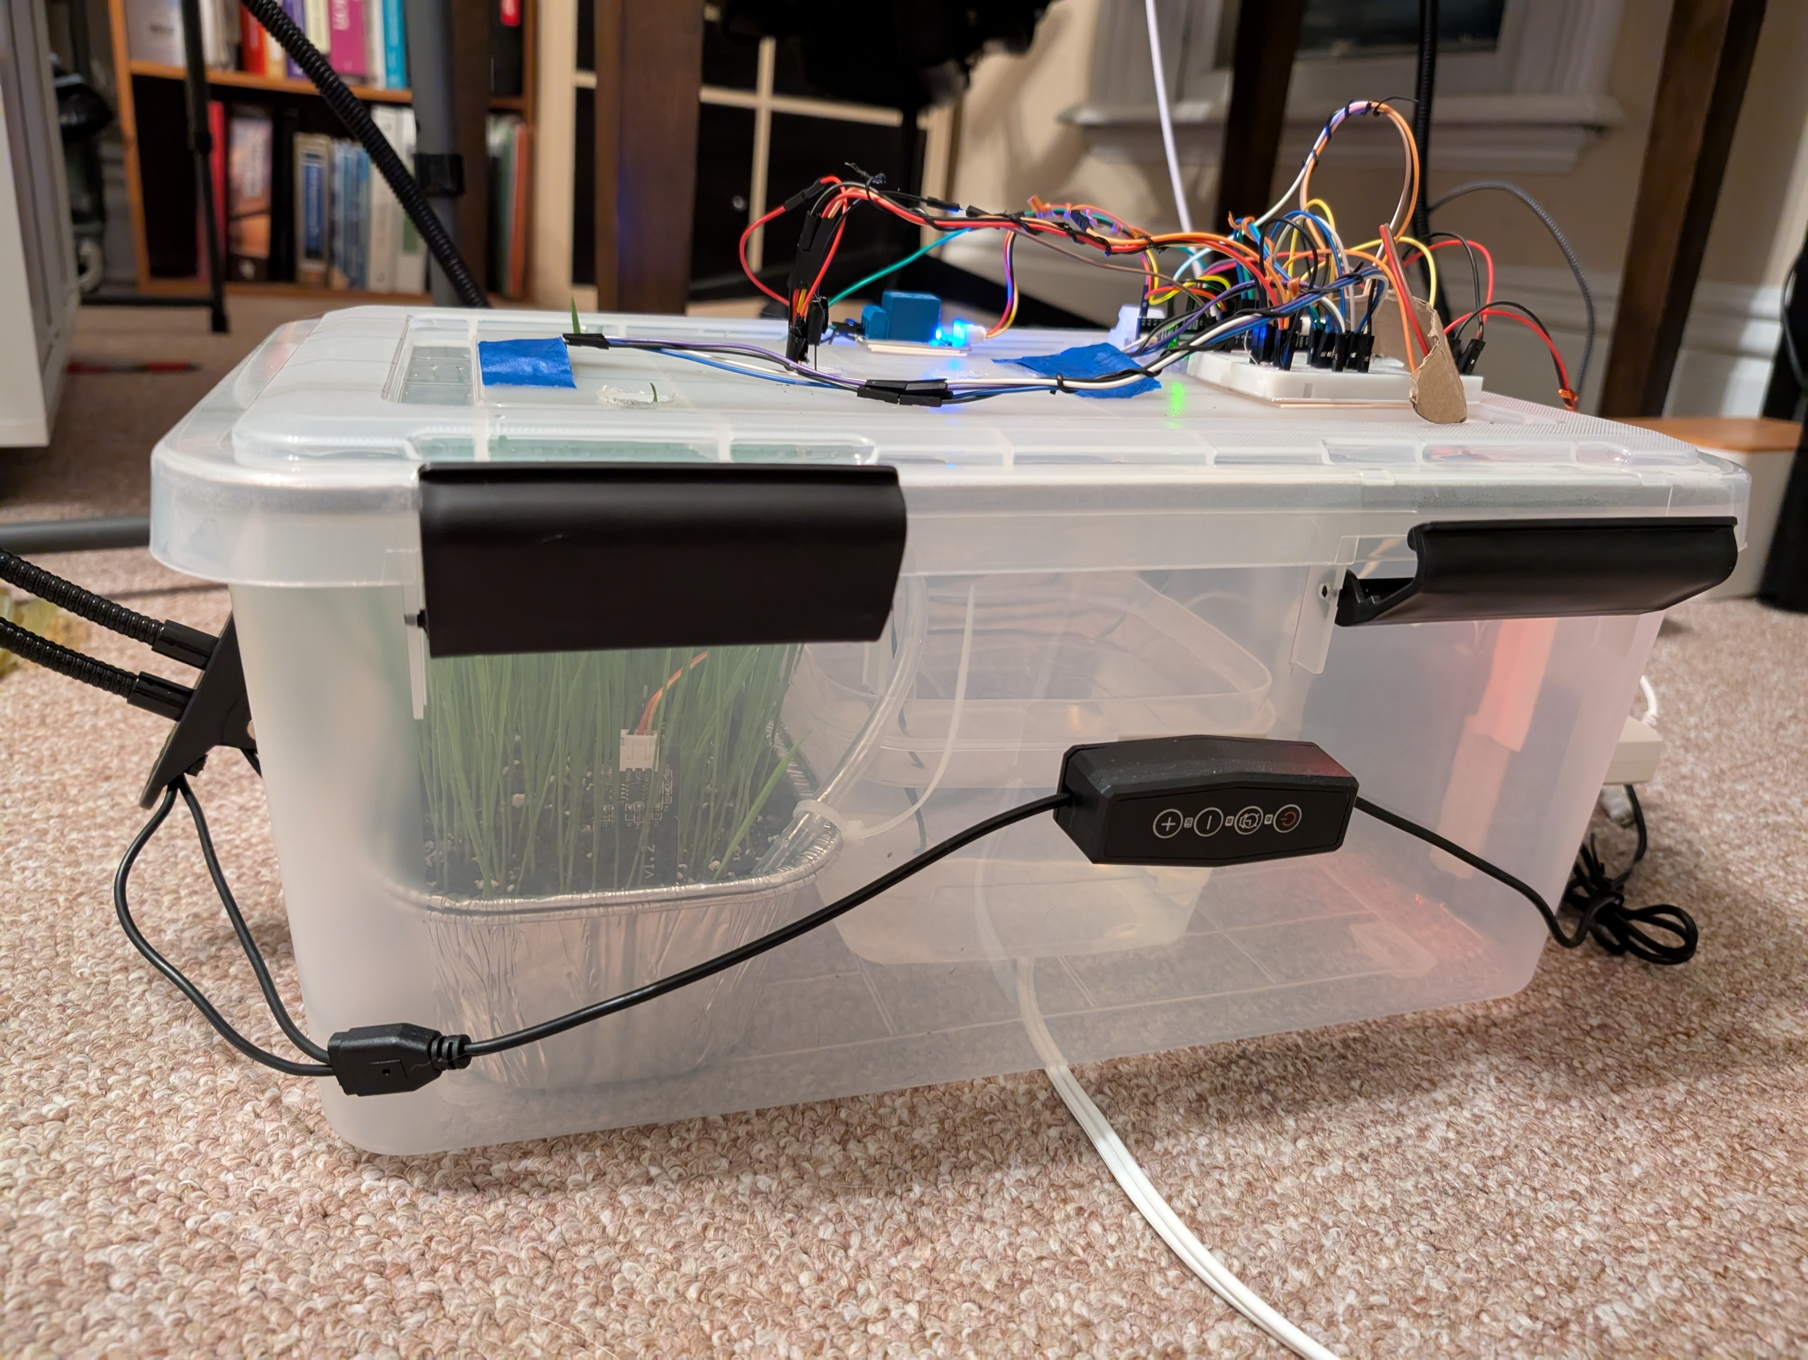
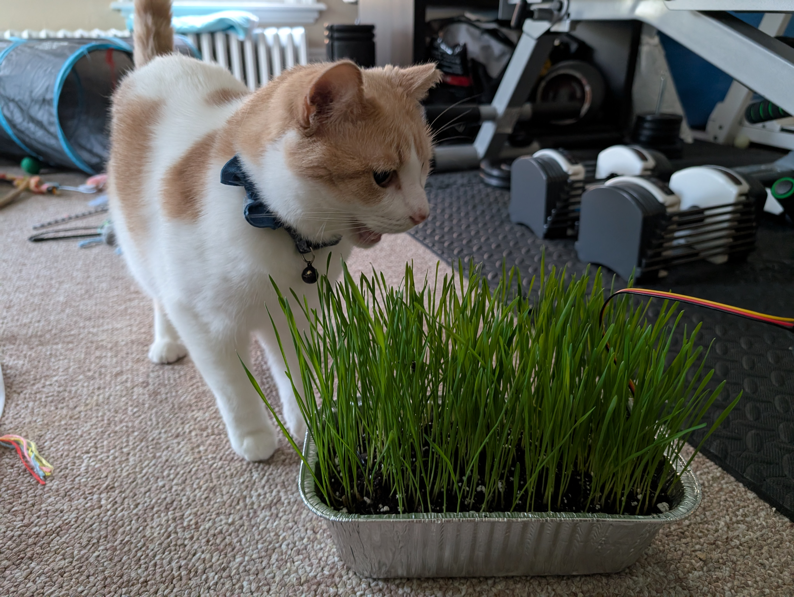
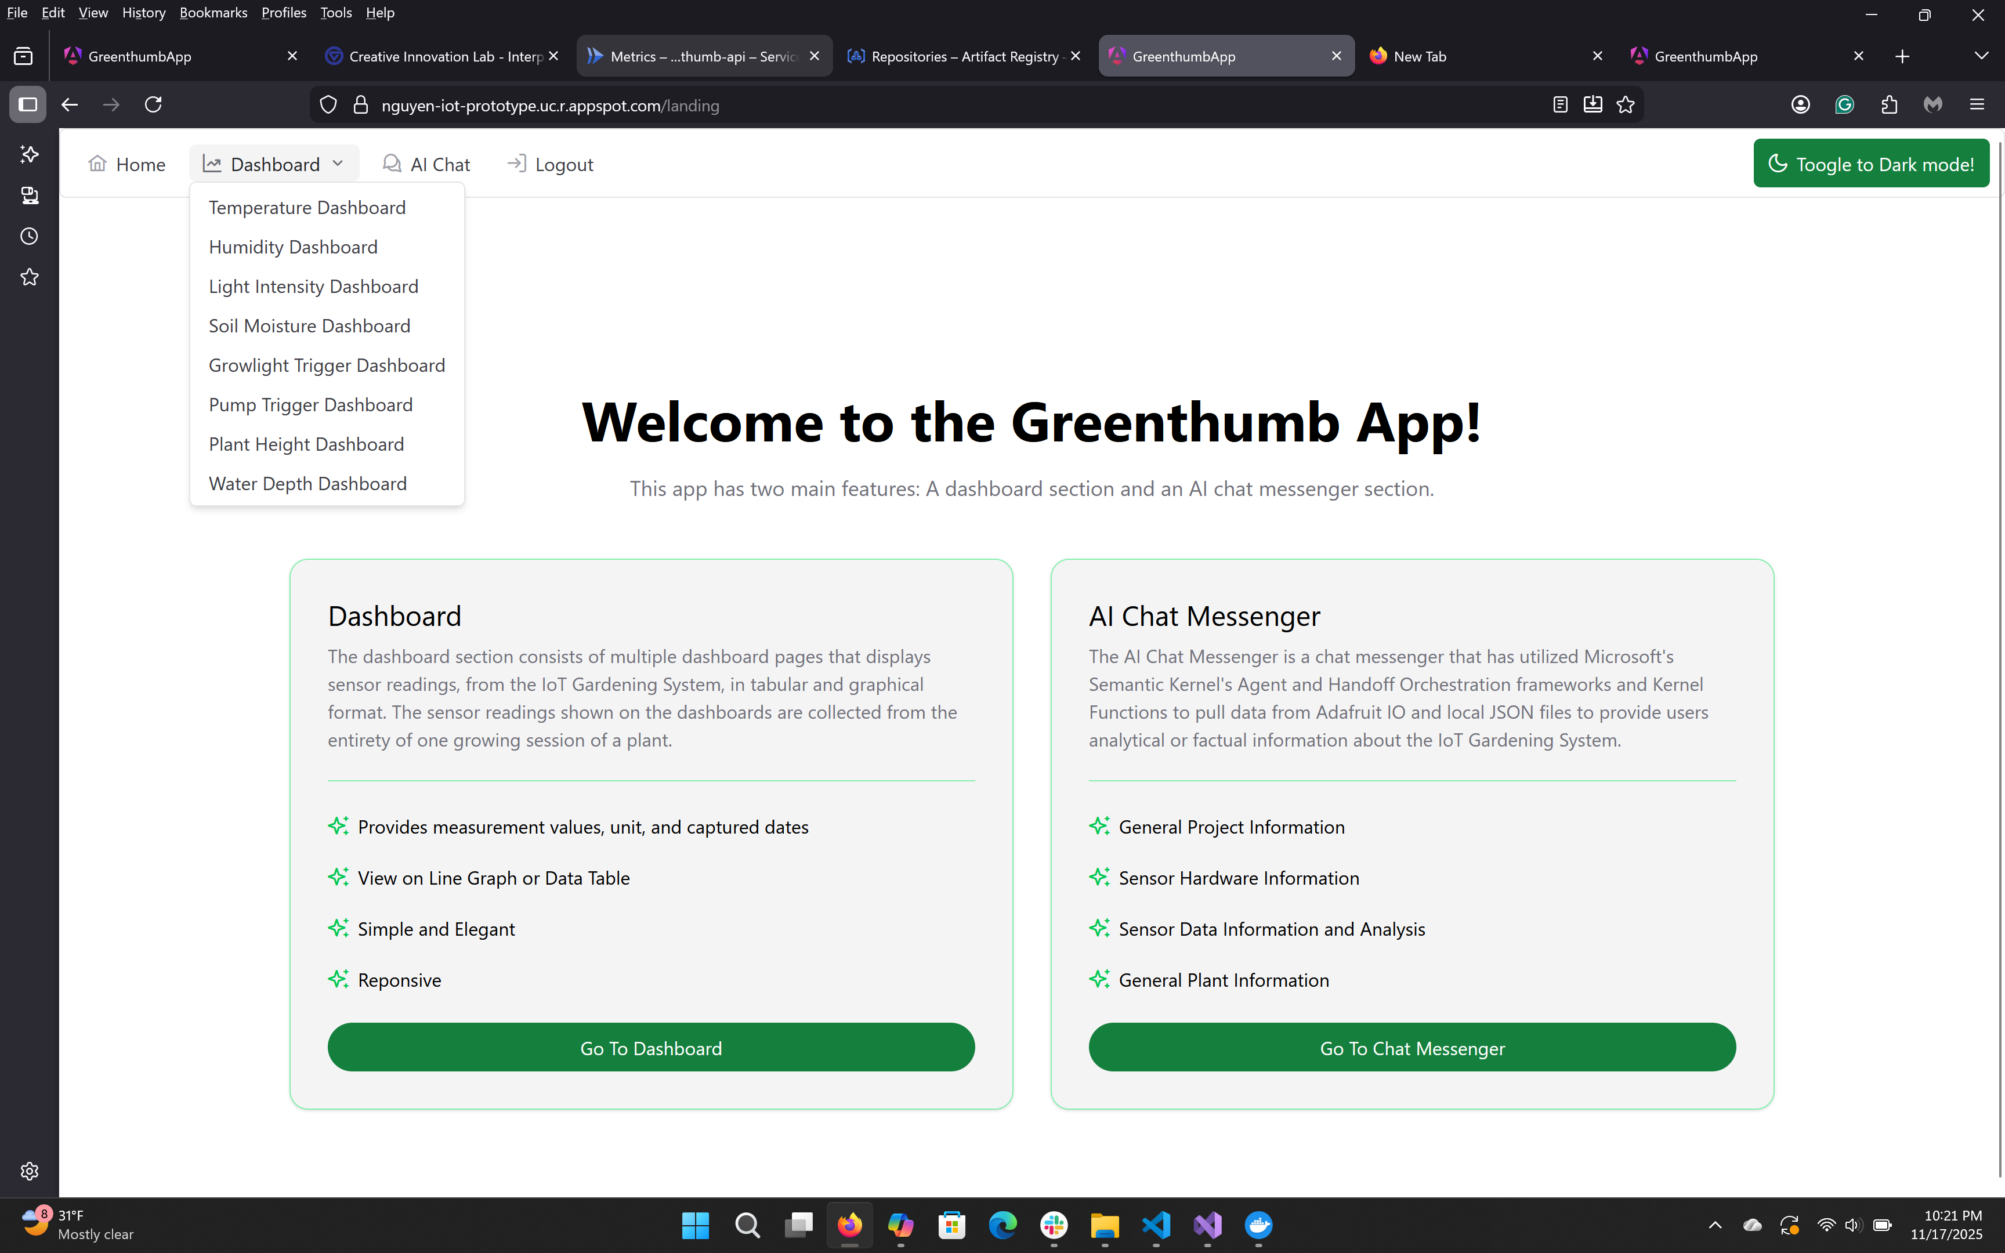
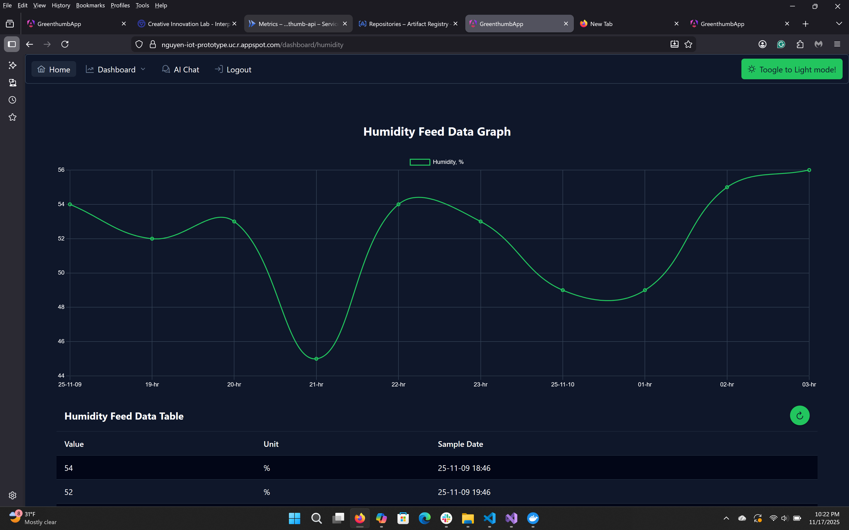
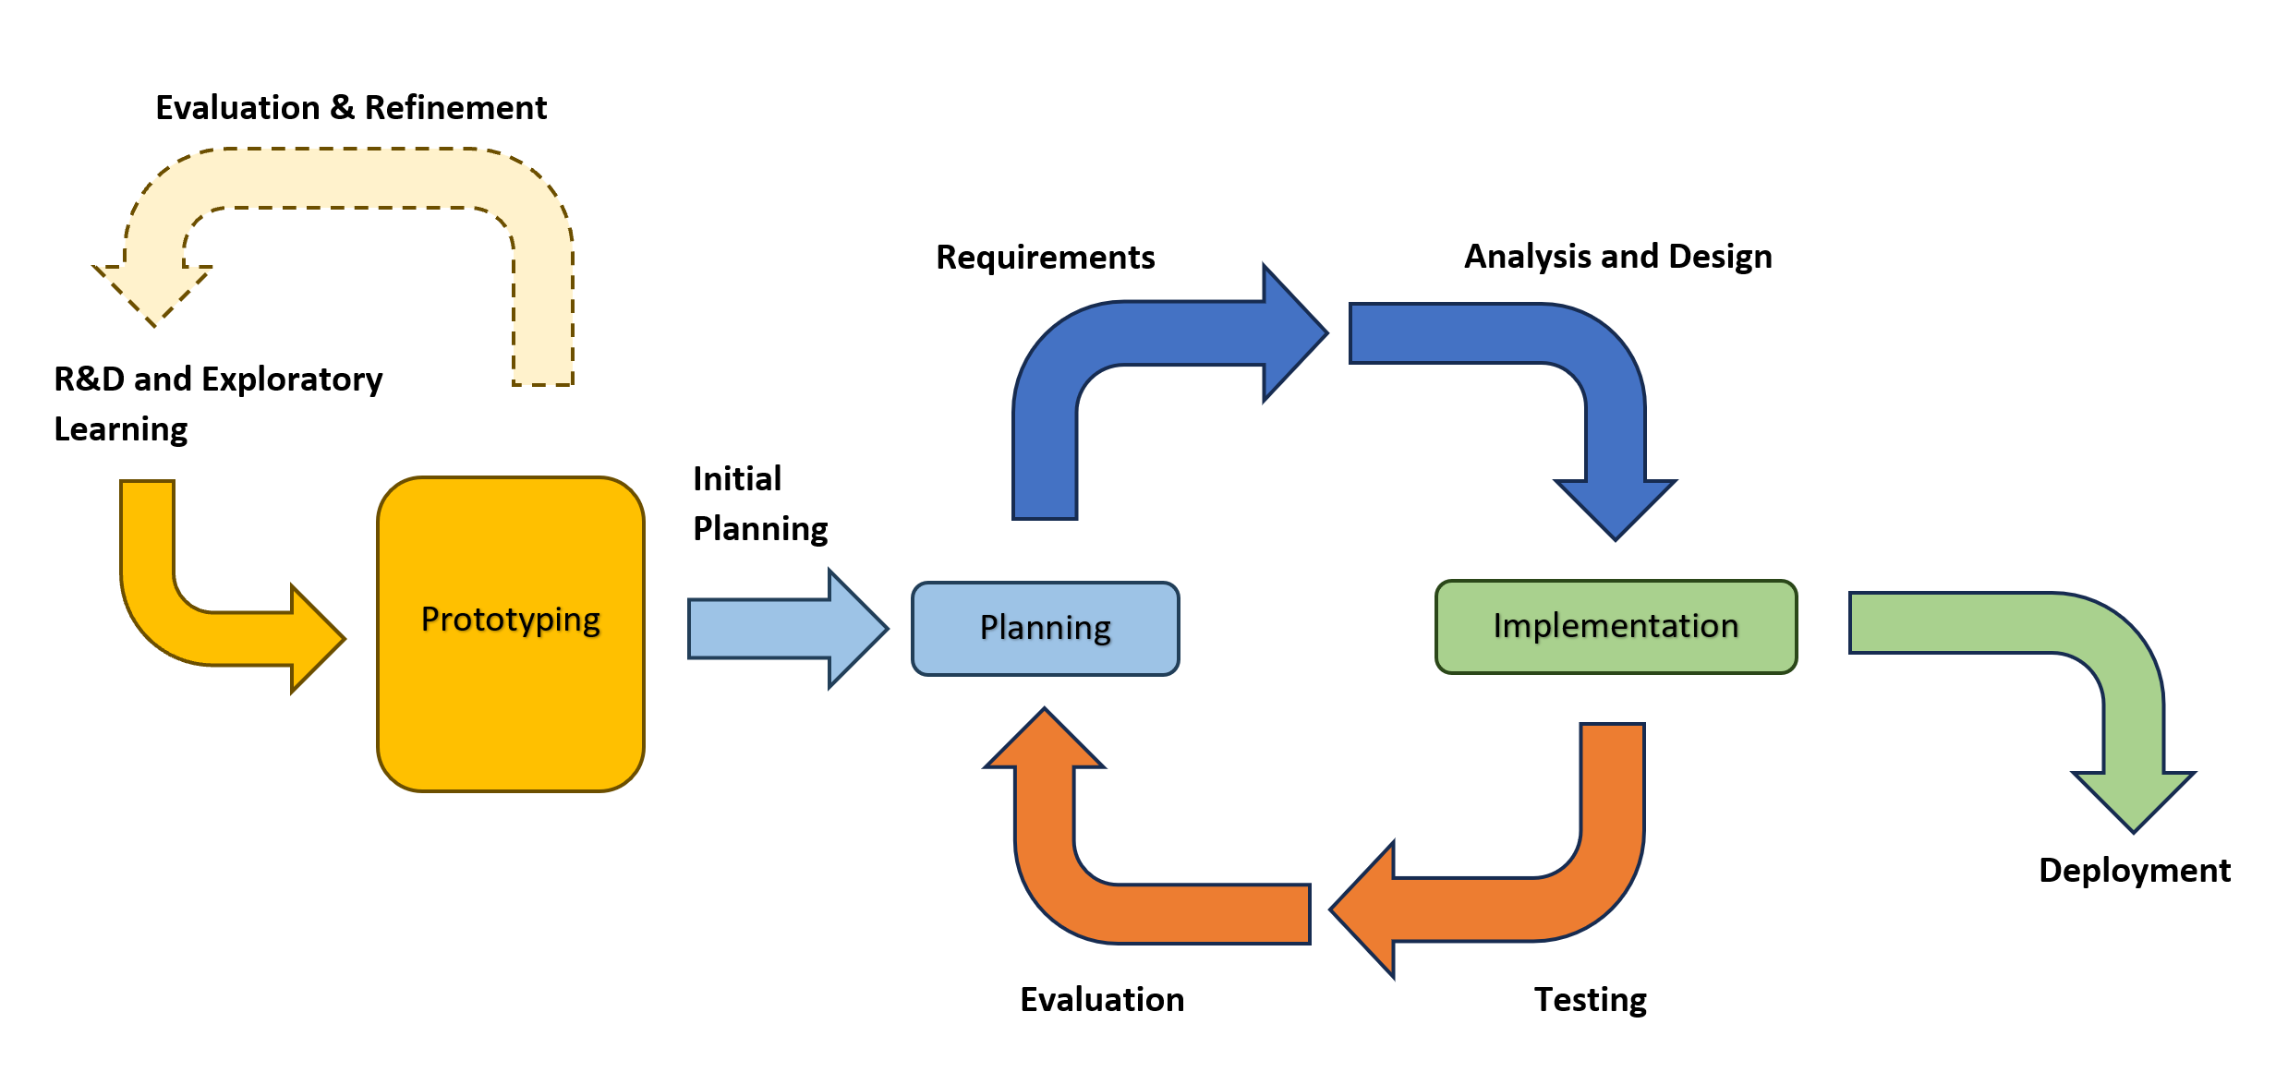
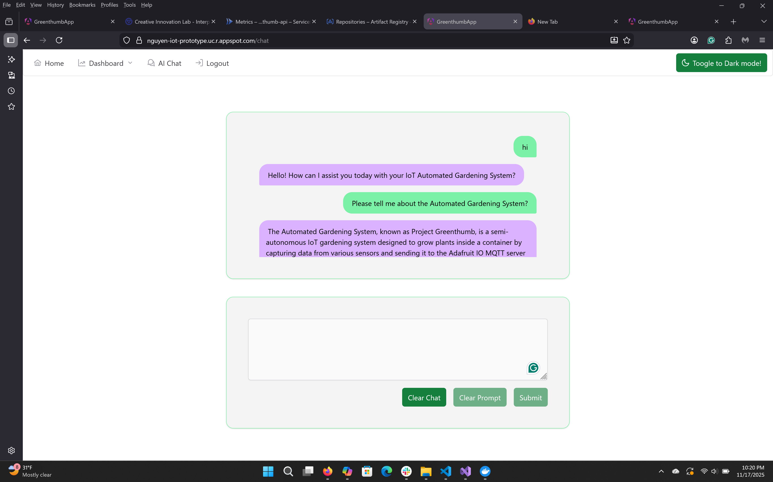
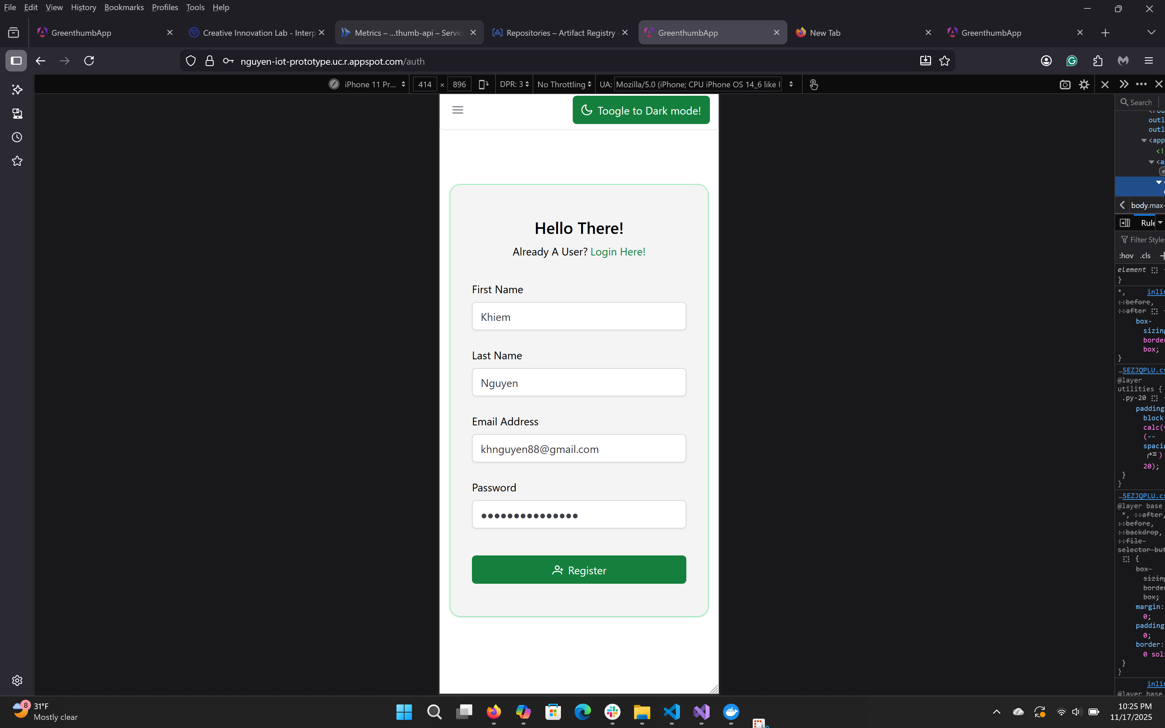
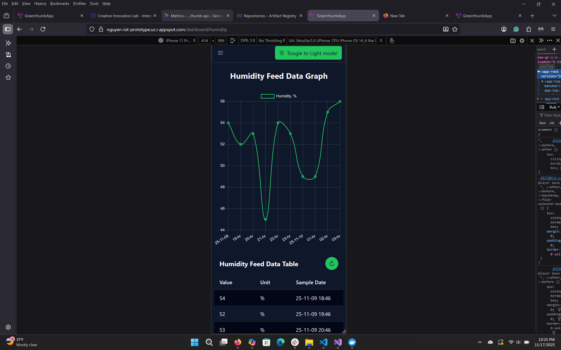
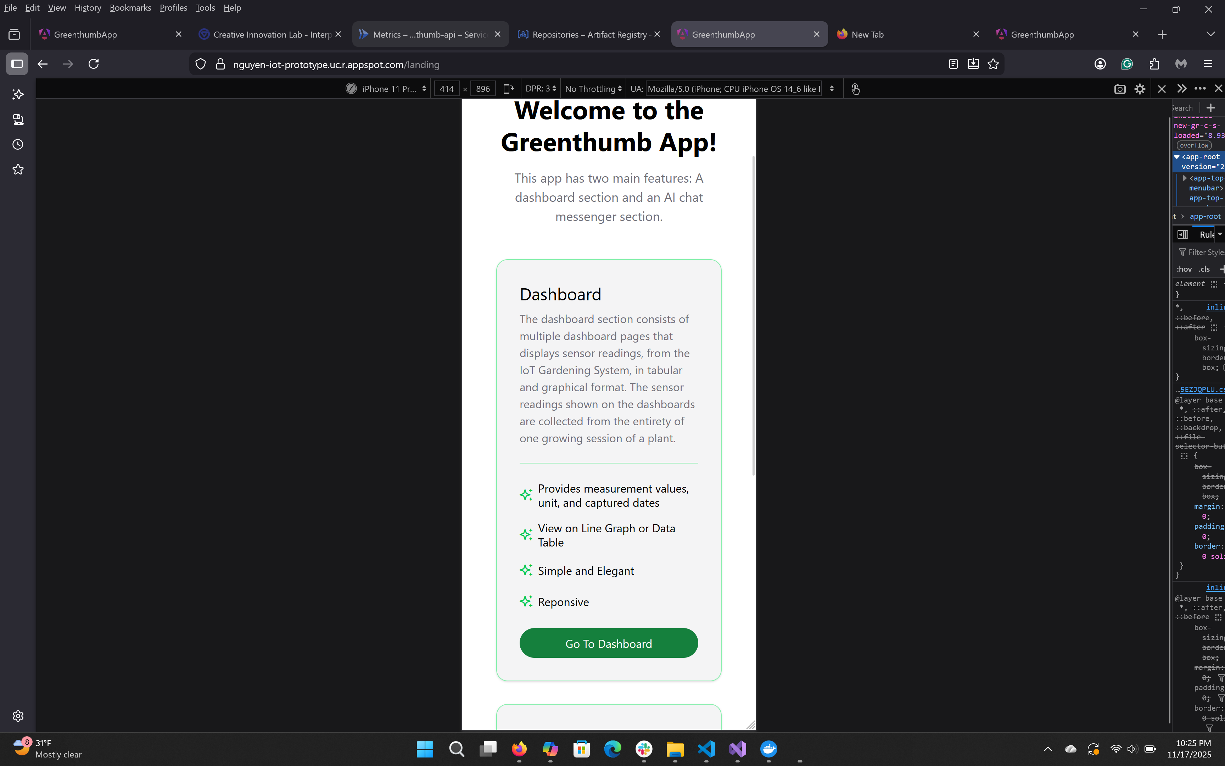
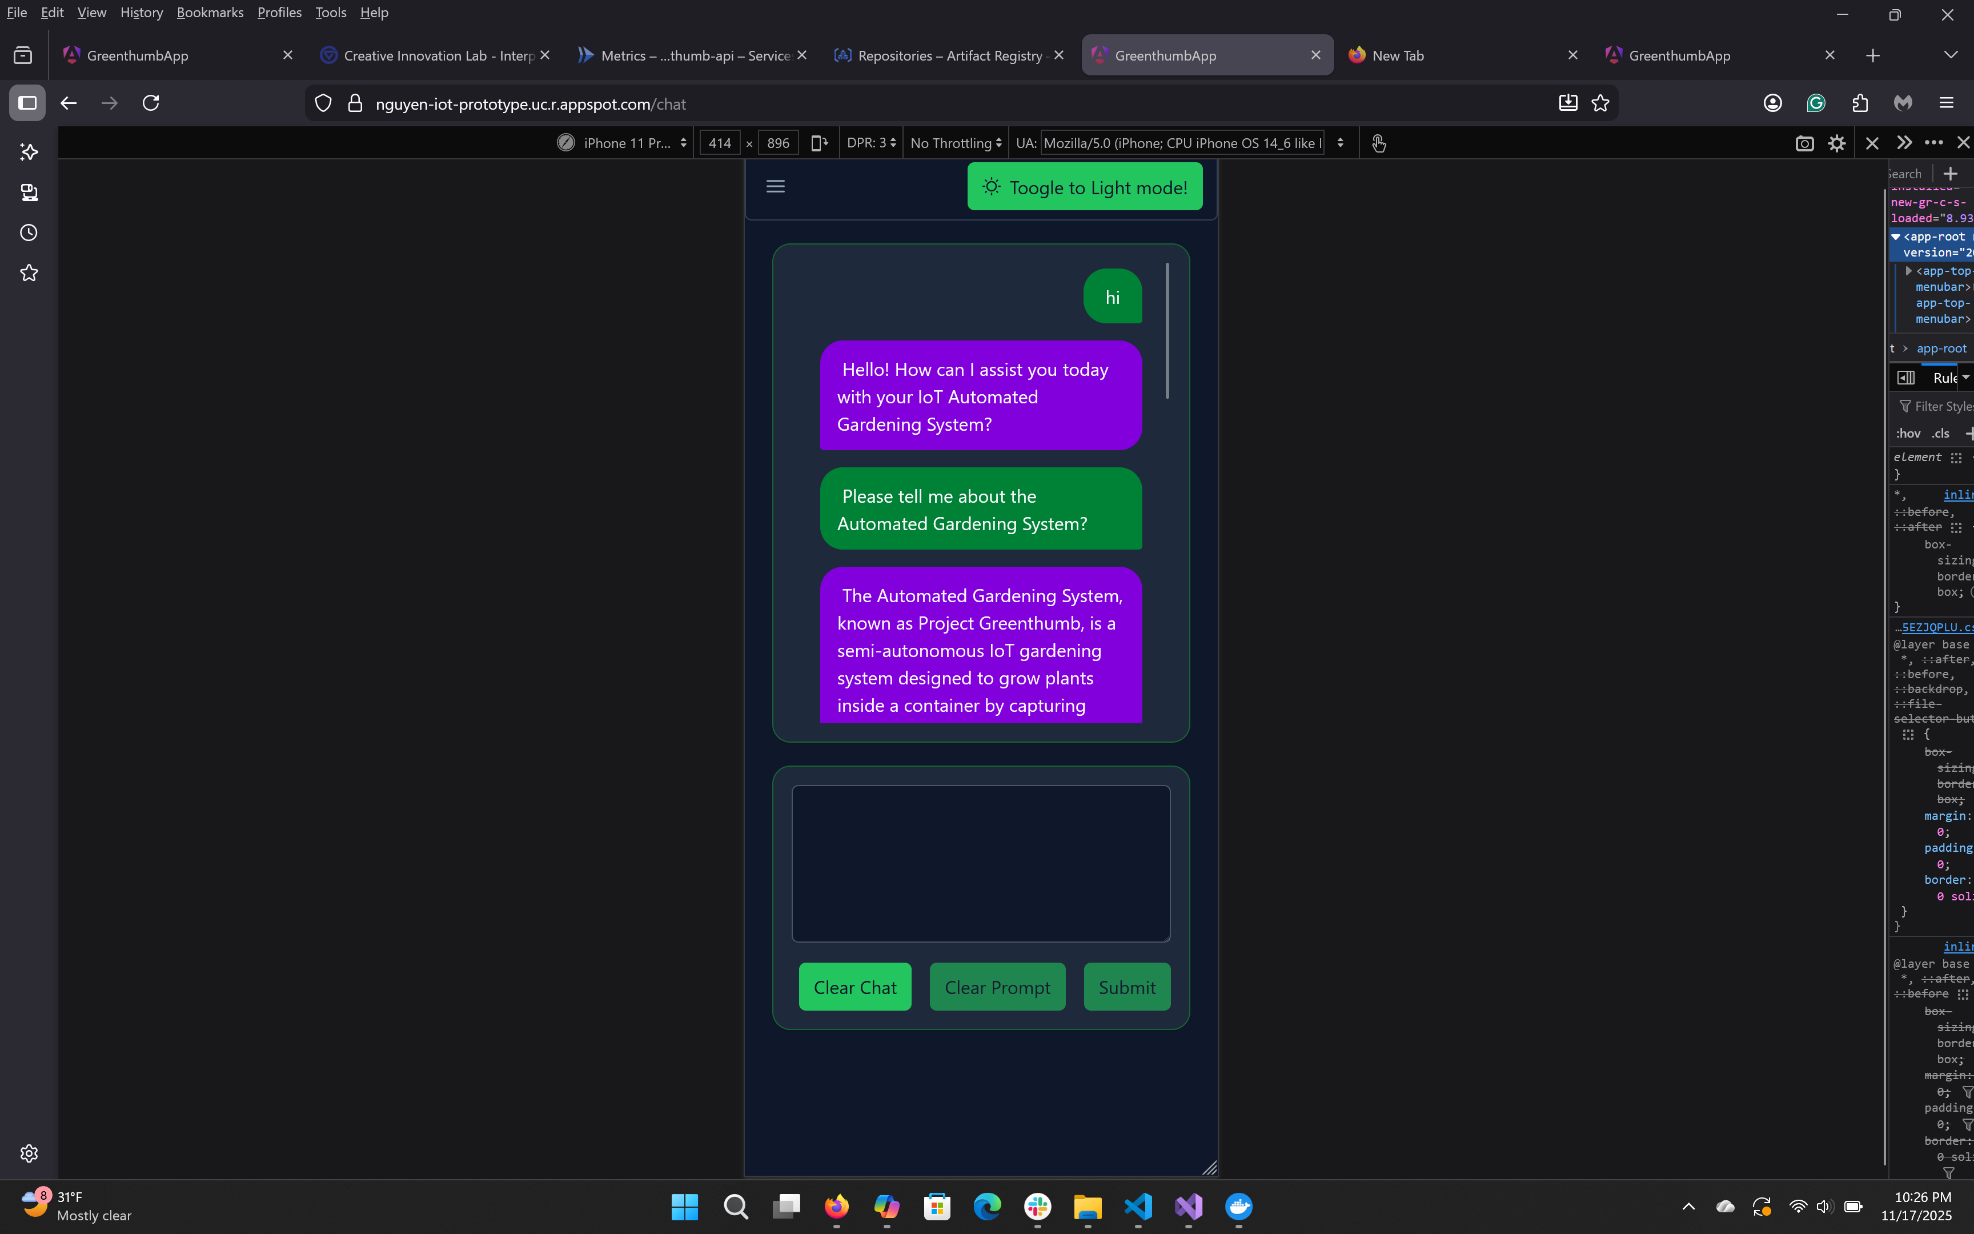
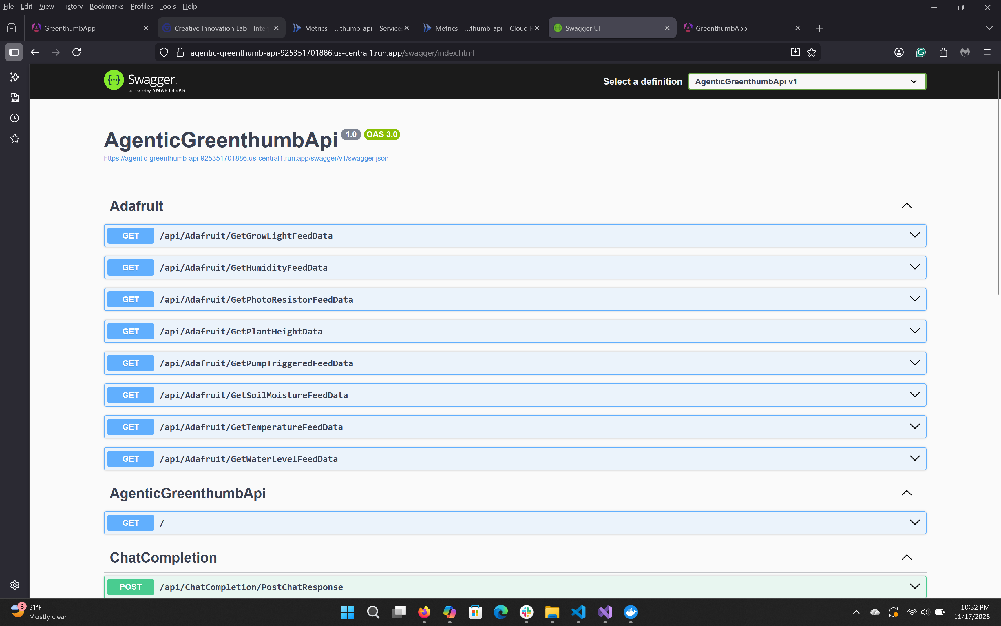

PROJECT GREENTHUMB:
SEMI-AUTONOMOUS IOT GARDENING SYSTEM
Khiem Hoang Nguyen
Advisor: Erik Fredericks
Results/Implementation
Introduction
`
Developmental Toolbox
Project Greenthumb was a semi-automated IoT gardening system that is comprised three subsystems:
1) Embedded system: A programmed Arduino with sensors and devices that read sensors, published data to the broker, and responded to sensor threshold parameters
2) Frontend web application: The user interface of the application used to display sensor data and chat with agents about the project
3) Backend REST API: An application that abstracted the logic behind the agentic chat messenger and sensor data processes provided endpoints to those services
The semi-automated IoT gardening system had the capability to grow plants with short growing periods (e.g., cat grass) from seed to maturity without any human intervention
Project Greenthumb began a few months before the Fall 2025 semester. Exploratory learning and prototyping for the embedded system started in July 2025, while agentic design and orchestration commenced in August 2025. The iterative developmental lifecycle began in September 2025
Visual Studio
Visual Studio Code
Arduino IDE
Angular Framework
PrimeNG Component Library
PrimeFlex CSS Utility Library
PrimeBlock UI Library
MS Semantic Kernel SDK
MS Kernel Memory SDK
C#
Typescript
C++
Adafruit IO
Microsoft Azure
Googe Firebase
Google Cloud Platform
Developmental Lifecycle
Technical Details
Embedded Hardware & Application :
Embedded system comprised of a programmed Arduino, multiple sensors (DHT11, Ultrasonic Sonar Sensors, Photoresistors, and Soil Conductivity Sensor), 5v water pump, 5v growlight, and relay devices.
Adafruit MQTT Library was used to publish sensor data to Adafruit IO
Concurrent timers were used to trigger staggered events such as sampling sensors, publishing data, and activating / deactivating devices
Frontend Application:
Had four main pages: Landing, Dashboard, Chat Messenger, and Auth
Developed using Angular and Prime libraries
UI was responsive & worked with various screens; Had light/dark mode
Utilized Google Firebase Authentication for user login, logout, & signup
Routes were protected. Unauthorized users could only access the Auth page
Backend Application:
Provided a service that was used to retrieve data from Adafruit IO and clean it up for external (frontend) and internal use
Provided a service that used to take user prompts & pass them through an agentic handoff orchestration, utilizing a remote LLM, to provide a response
The agents and handoff orchestration were created using Microsoft’s Semantic Kernel SDK, and are all driven by an LLM service under the hood
Handoff orchestration was a process used to get a group of agents to coordinate with one another to find an agent that could best fulfill a user request, and assign the responsibility over to them
The orchestration found the agent responsible for handling the request by evaluating each agent based on their role, responsibilities, and tools and found one that best matches the context of the prompt or request
Cloud Services:
Google Cloud Platform deployed the frontend & backend applications
Google Firebase provided authentication for frontend application
Azure hosted and deployed LLM Model used in backend application
Adafruit IO was used as MQTT broker and a database service
The project followed a hybrid software developmental process, that combined the Exploratory and Iterative Developmental models. The initial part of the process relied heavily on prototyping and the development of throwaway applications to build the knowledge on concepts and topics that were never covered in the graduate program’s academic curriculum or used at work, such as embedded design and circuitry, IoT, and agentic design. The exploratory process helped refine the project’s scope and feasibility based on the knowledge gained and contributed to the initial plans for the project’s iterative developmental lifecycle.
Try the App
Here
Proposed Future Improvements
Embedded Hardware & Application :
Upgrade the ultrasonic sonar sensors with water meter sensor, LiDAR sensor, and camera to improve accuracy measuring plant growth and water supply levels.
Refine existing code, continue support for the ultrasonic sensor, and implement code for new sensors and camera
Adjust concurrent timers and frequency of sensor reading and data publication to Adafruit IO (MQTT Broker)
Enable MQTT subscription features to allow users to adjust parameters while the Gardening System is running
Frontend Application:
Add Embedded System Settings page for embedded application parameters customization
Add a Users Settings page for web application customization
Backend Application:
Revise and make the Chat Completion Service extensible by giving users ability to generate and configure agents and orchestration through YAML template and config files; including LLM model selection
Create an extensible Data Service and interface to support different database services and connection, including local database, that can be selected via a configuration file.
Implement new service to accept and process images from camera
Major Challenges and Solutions
Embedded Hardware & Application :
Had limited knowledge in circuitry, the C++ language, and IoT, but learned and applied them to the application in a short timeframe, through reading online forums and official documents, and prototyping
Encountered sensors that provided faulty readings, required the development of a checklist of every root cause encountered and its utilization to streamline the debugging process
Ran into an issue where VS Code IDE could not find the Arduino Library, and developed a workaround by coding in VS Code IDE and compiling and debugging code in Arduino IDE
Frontend Application:
The Angular UI Component Library, PrimeNG, updated its theming system and style customization process, and had poor documentation, but a new theming system was learned through online resources
Backend Application:
Had limited knowledge in agentic design and orchestration, but learned and applied them to the application through reading Microsoft Semantic Kernel documentation and building prototypes
Cloud Run deployment of the backend application onto the cloud required an additional process of generating a Docker image of the application and uploading it to GCP’s Artifacts Registry

